Slide 1
A-Eye
The visual assistant app

Slide 2
Meet our team
Malintha Leitan
Adithya Perera
Product Owner:
The person responsible for defining what the development team should build.
Scrum Master:
The person who facilitates the Scrum process and helps the development team work together more effectively.
Deneth Gunawardena
Danidu Dameera
Developer:
A member of the development team responsible for building the product.
Developer:
A member of the development team responsible for building the product.

Slide 3
The Problem
A non-negligible number of students in Universities suffer from visual impairments such as Macular Degeneration or Cataracts.
This hinders their ability to read text which will cause problems when they are in a classroom.

Slide 4
What is A-Eye
A-Eye is the solution to this problem.
It is an AR based text-to-speech application.
It scans the text using the phone’s camera and reads it out loud through the phone speaker for the user to hear.

Slide 5
Our Agile Techniques
Time Boxing
Planning Meetings
Sprints
Using the Trello boards, we allocated a fixed amount of time for each task.
Using Teams and Google Meets we held planning meetings to plan our sprints.
Using the Trello board as a reference, we prioritized items from the product backlog to work on in each sprint.
Review Meetings
Sprint Retrospective
We had regular review meetings to see how each sprint is proceeding.
We held retrospective meetings to reflect on the completed sprint. We added the takeaways to a Miro Board.
Our Trello Board:
https://trello.com/invite/userworkspace91709587/ATTI77cd0741103e6fb00d2448cce3587f6e97FD0C9B
Our Miro Board:
https://miro.com/app/board/uXjVPhAoXGY=/?share_link_id=428630202629
Product Backlog
Sprint Backlog
The Trello board also contains the Product backlog to see which are the requirements.
Trello board was also used for Sprint Backlogs which are items selected from the product backlog to complete in a sprint.

Slide 6
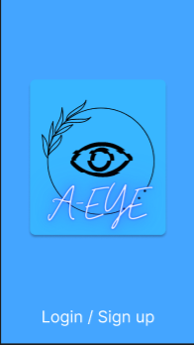
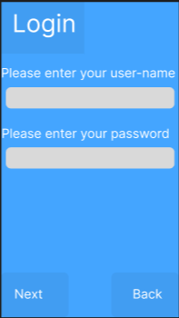
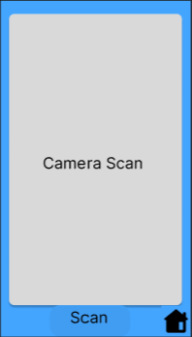
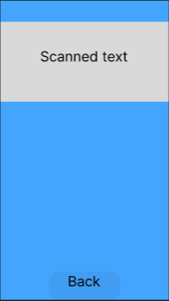
Our Design
Prototype made using Figma
https://www.figma.com/proto/wGCYtN0gLStO9tQOxlWO5P/TheThirdEye?type=design&node-id=1-2&scaling=scale-down&page-id=0%3A1&starting-point-node-id=1%3A2
Notable Features
Simple navigation between screens.
Use of Images and Logo.
Consistent color theme.
Use of larger buttons, text and symbols.

Slide 7
Legal, Social, Ethical and Professional Issues we faced
We had to ensure the app complies with the relevant laws regarding people with disabilities.
We had to design the app in a way that it does not discriminate against individuals with visual impairments and should be accessible to all individuals regardless of their disability status.
The app should be transparent about its functionality and how it uses user data. Provide clear explanations of how the app works, as well as any data it collects and how that data is used.
We had to ensure that the app respects the autonomy and dignity of people with visual impairments.

Slide 8
The Development Tool - Unity
Unity is a cross-platform development tool.
Allows developers to create 2D and 3D interactive experiences.
Can develop for various platforms, including PC, mobile devices, consoles, and AR/VR devices.

Slide 9
Timeline
Continue Development in Unity
Deploy Testing Strategies
Early February
Sprint 1
Technical Plan
Schedule
Mid February
Sprint 2
Literature Reviews
Research
Early-Mid March
Begin Sprint 3
Create Prototype
Begin basic setup for Unity
Late March
Extension of Sprint 3
Begin Development in Unity
Begin Sprint 4
April

Slide 10
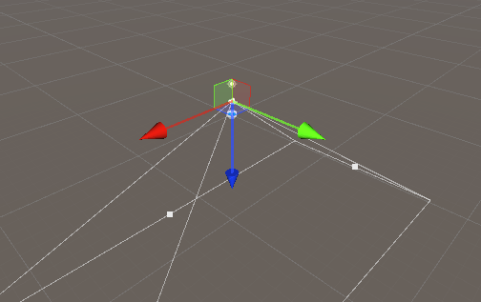

Our App
Demonstration

Slide 11
Testing Strategies
Continuous Integration: Integrating code changes on a frequent basis.
Regression Testing: Run tests on previously developed features after changes.
Manual Testing after each iteration.

Slide 12
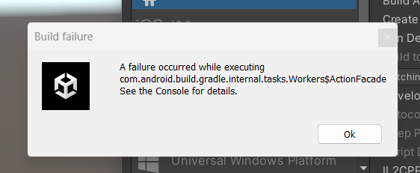
Problems we Faced
One Team Member leaving the project.
Delays in Sprint completion.
Irregular Meetings.
Several Build Errors.

Slide 13
Our Solutions
Redistributed the workload.
Extended Sprints to meet deadlines.
Made up for missed meetings.
Fixed Errors.

Slide 14
What we’ve learnt
Teamwork – How to work as a team in a professional medium.
Technology – How to develop applications using Augmented Reality for mobile platforms.
Tools – How to use Trello, Miro and Unity.
Techniques and Agile Developments – Scrum, Sprints, Time Boxing, Meetings, Backlogs

Slide 15
The Future
Differences we’d make:
Distribute the workload more evenly.
Research more on the tools used.
Improvements we’d make
Have meetings more regularly.
Follow scrum practices more closely.
If we had more time
Add more sprints to further develop the application.
Utilize more Testing Strategies such as UAT.
Fix our build errors.

Slide 16
Thank you

